Slide 1
International Baccalaureate (IB)
Middle Years Program (MYP)
ATM King’s College London
Sara Brouwer

Slide 2
International Baccalaureate
Four programmes
IBPYP
IBMYP
IBDP
IBCC

Slide 3
IB Learner Profile
Inquirers
Knowledgeable
Thinkers
Communicators
Principled
Open-minded
Caring
Risk-takers
Balanced
Reflective
http://www.ibo.org/
Notes:
Sara about context of MYP

Slide 4
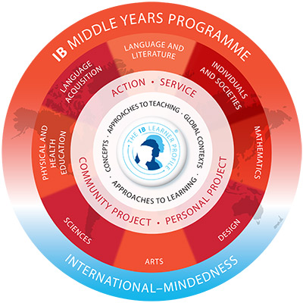
MYP
Middle Years Programme model
http://www.ibo.org/
Notes:
Layla

Slide 5
Middle Years Programme (MYP) currently
Grades 6 to 10
Areas of interaction
  Approaches to learning
  Community and service
  Health and social education
  Environments
  Human ingenuity
Cross curricular projects
Notes:
Sara

Slide 6
What can Collaboration look like?
Collapsed day (Human Ingenuity Day)
Focus on an Area of Interaction (Trebuchets/Brunel)
Focus on a curricular theme (Wonderful Decade)
Focus on a single activity (World Summit)
Notes:
Sara

Slide 7
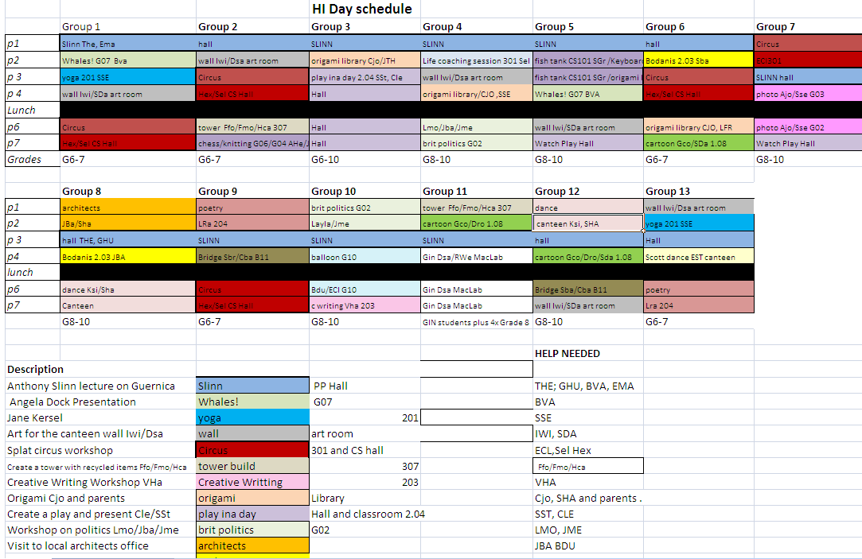
Human ingenuity Day
Notes:
Sara

Slide 8
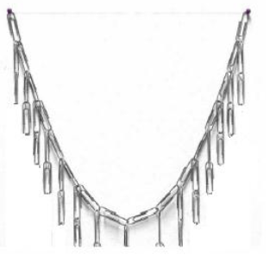
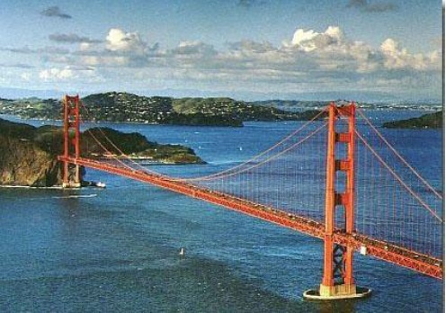
Human ingenuity Day
https://www.georgiastandards.org/Frameworks/GSO%20Frameworks/Accelerated_Math_II_Unit_7_Student_Edition_11-4-09.pdf
Notes:
Catenary
Sara

Slide 9
Area of interaction (human ingenuity)
In design and technology students planned and made a trebuchets
In Mathematics students went to a nearby park and filmed path of ball and in the classroom found an equation to fit the curve
Notes:
Sara

Slide 10
Brunel
Grade 10 (year 11) Mathematics (Extended) and Physics Students
Cross curricular unit
Jointly taught by mathematics and physics.
Single project prepared by students assessed by different criteria according to subject
Notes:
Sara

Slide 11
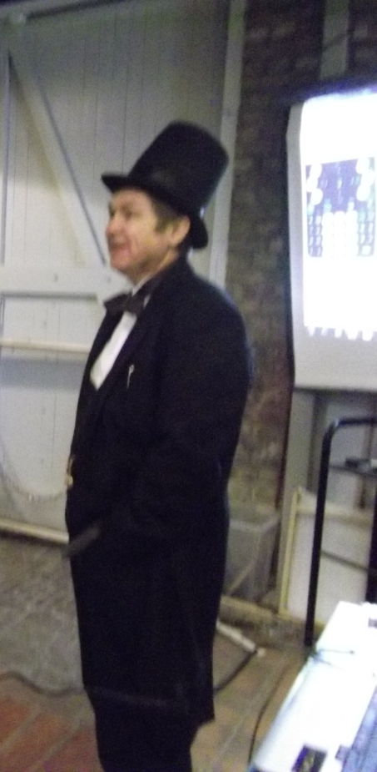
Brunel Museum visit
Measuring air resistance with TINSpire and mobile
IKB links history to the experiments
Swinging pendulum

Slide 12
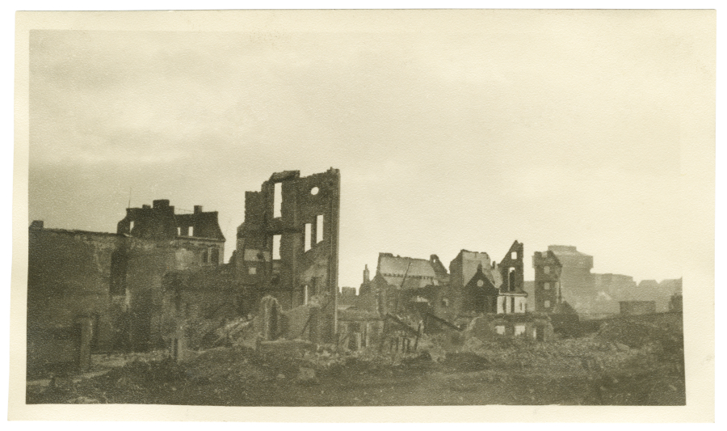
Wonderful Decade Project
The ‘It’s a Wonderful Decade’ unit is a cross-disciplinary unit which explores the legacy and innovations of the 1940s.
The title is reminiscent of one of the most iconic films of that decade ‘It’s Wonderful Life’ (1946, Frank Capra) and also refers to the many wondrous developments during this decade which have directly influenced modern society.
Notes:
Layla

Slide 13
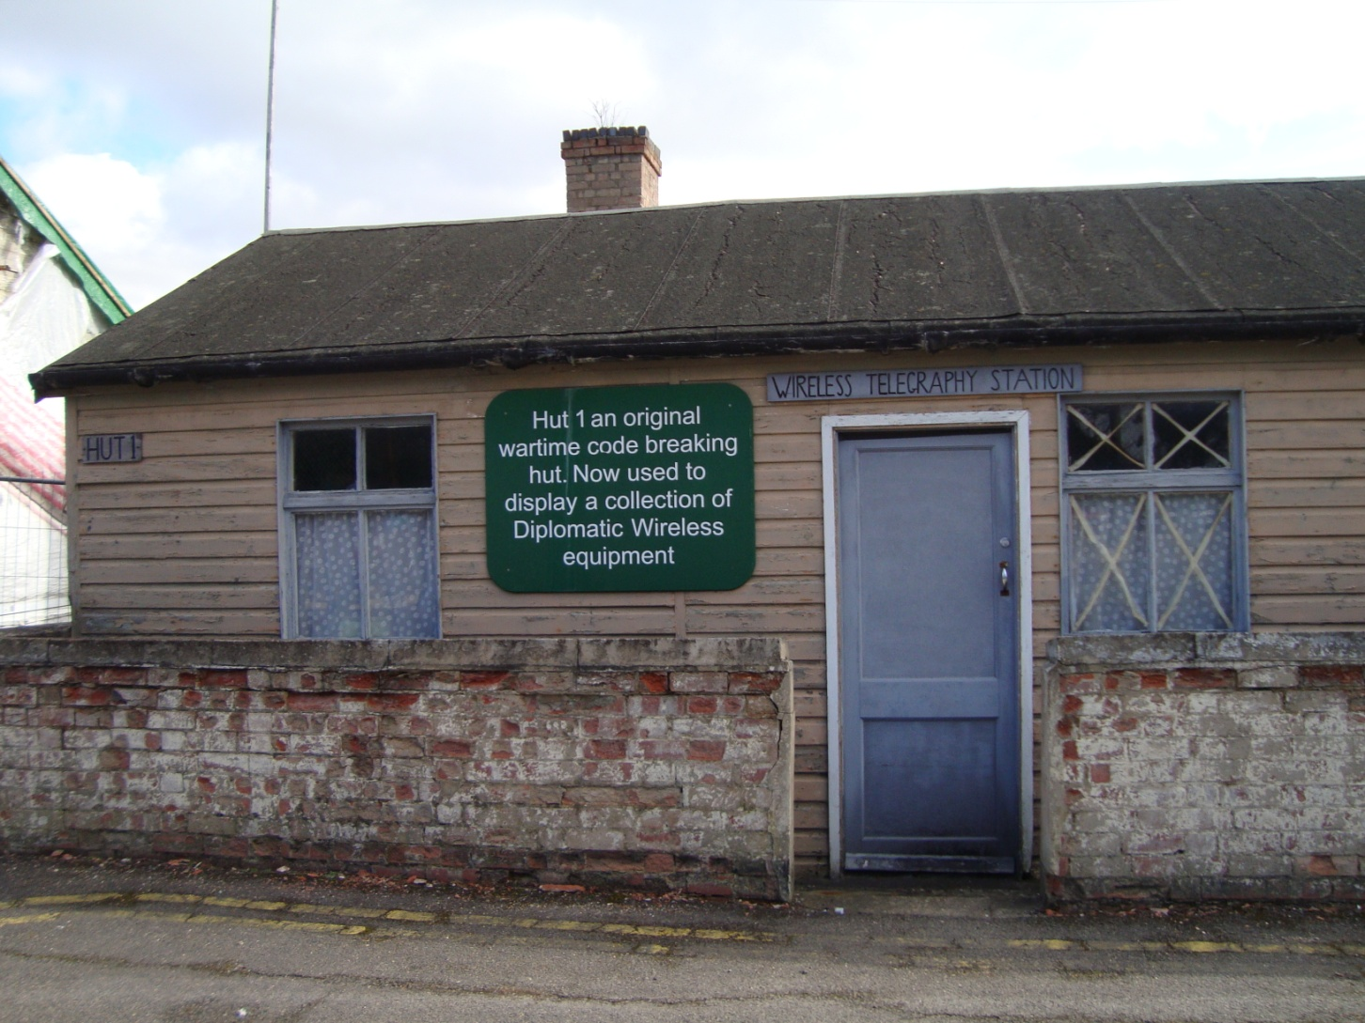
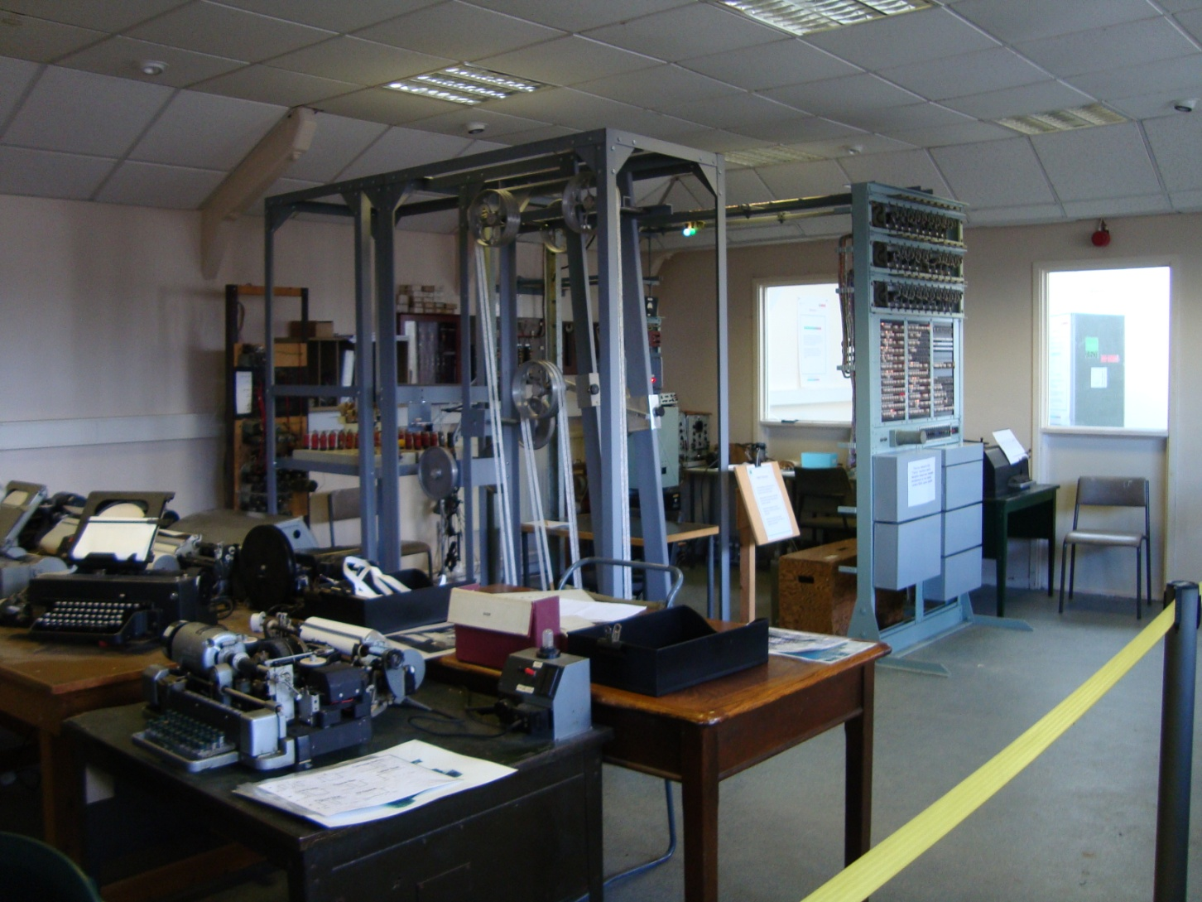
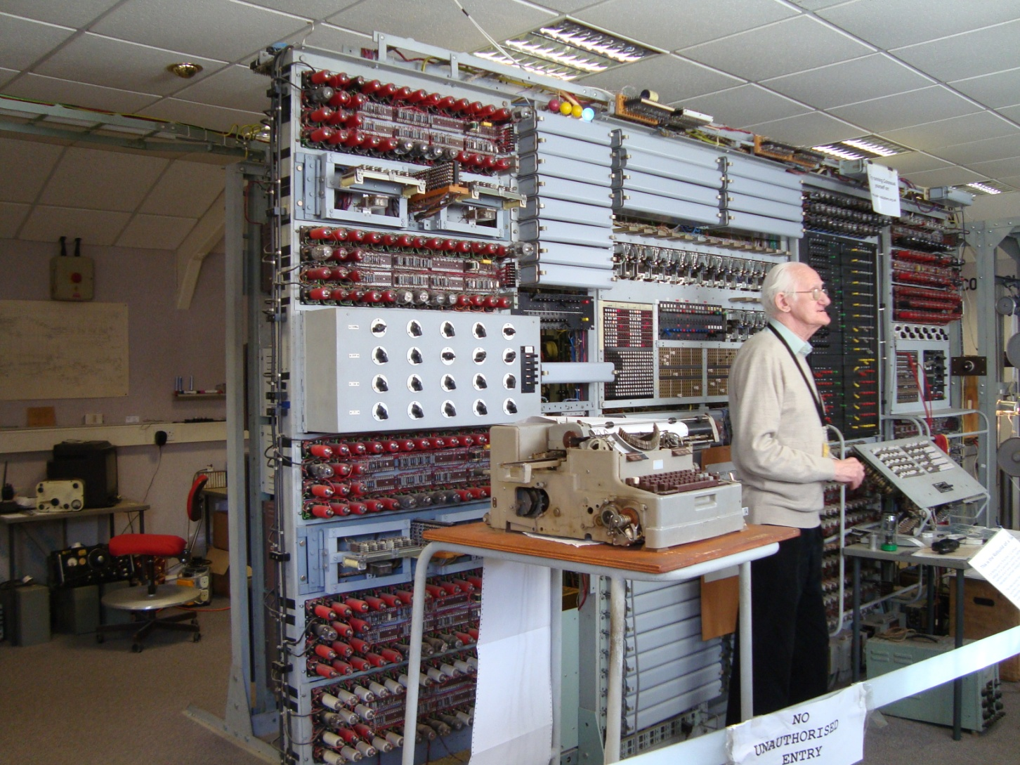
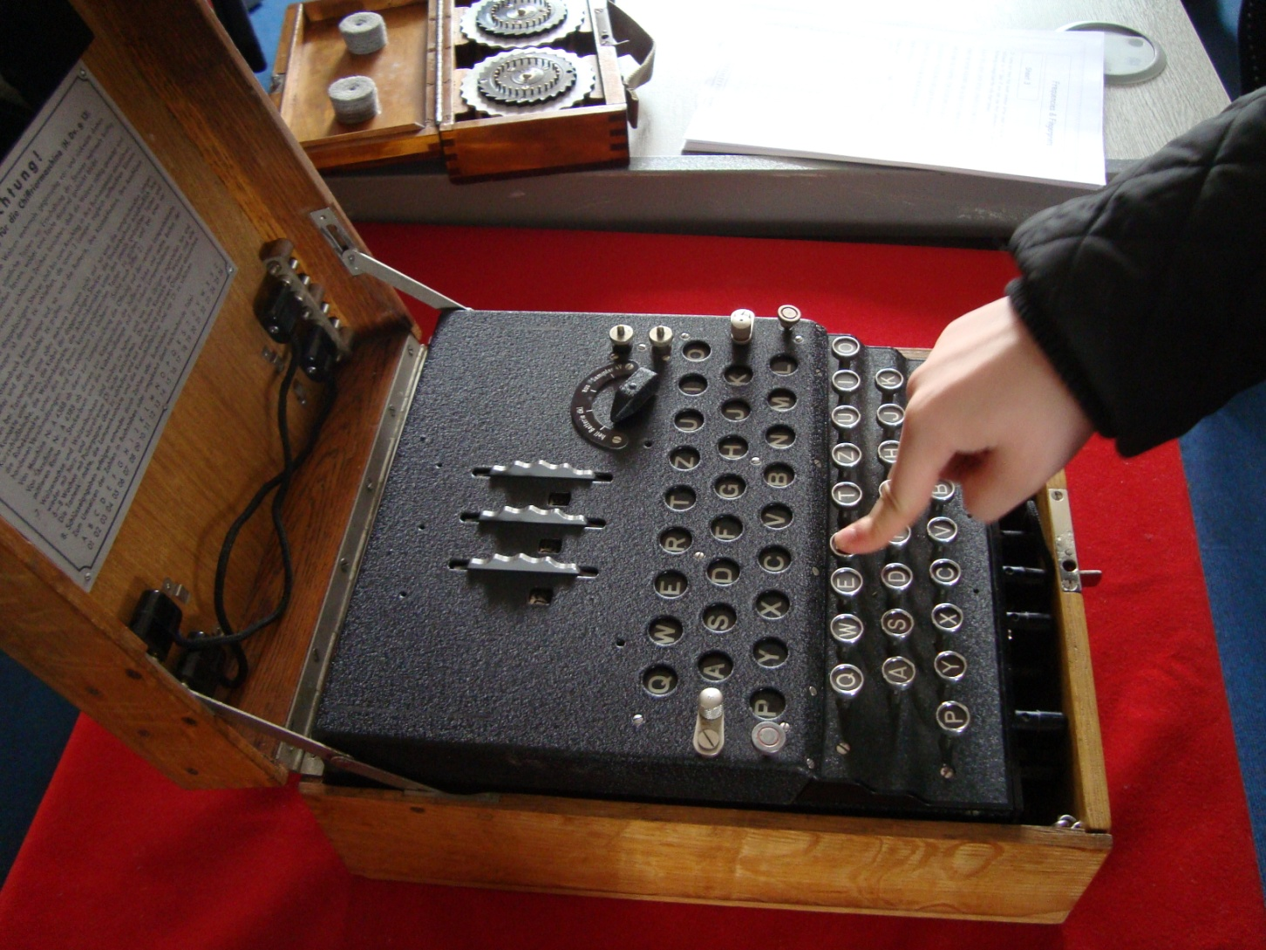
Bletchley Park Visit
Notes:
Layla

Slide 14
Next Chapter
Knowing and Understanding
Investigating
Communicating
Applying
Notes:
Layla

Slide 15
E-assessment
MYP 5
Pilot
interactive
Notes:
Sara

Slide 16

Notes:
Both

