Slide 1
Mixed Attainment Maths
Mark Horley, St. Marylebone CE School, Westminster
@mhorley
mark.horley@gmail.com

Slide 2
mixedattainmentmaths.com

Slide 3
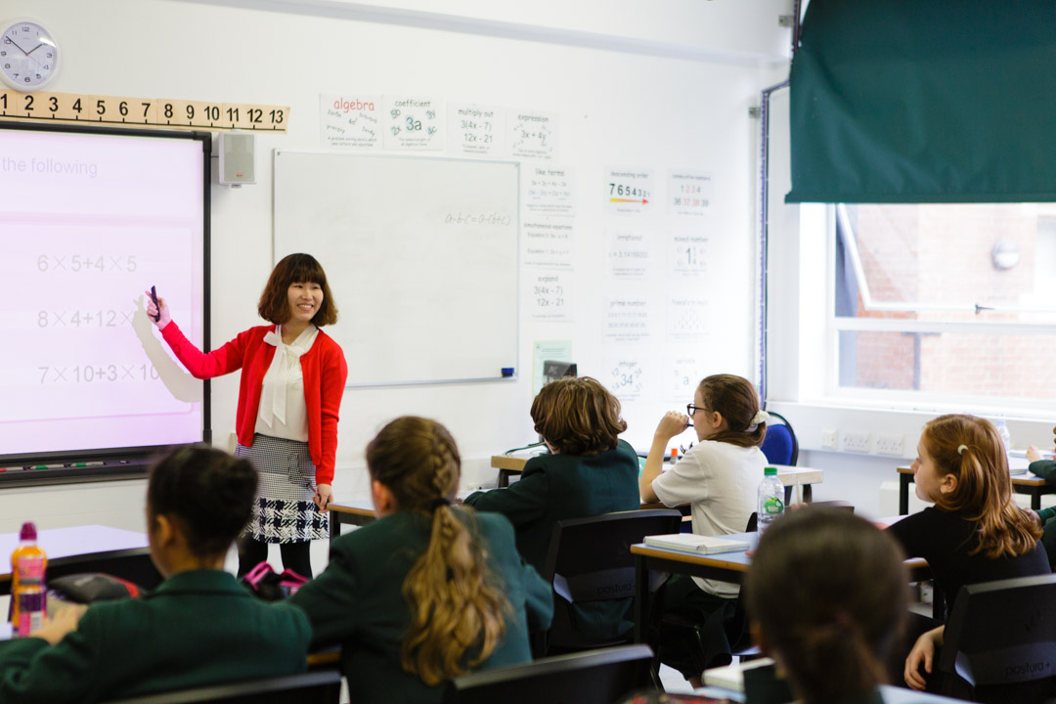
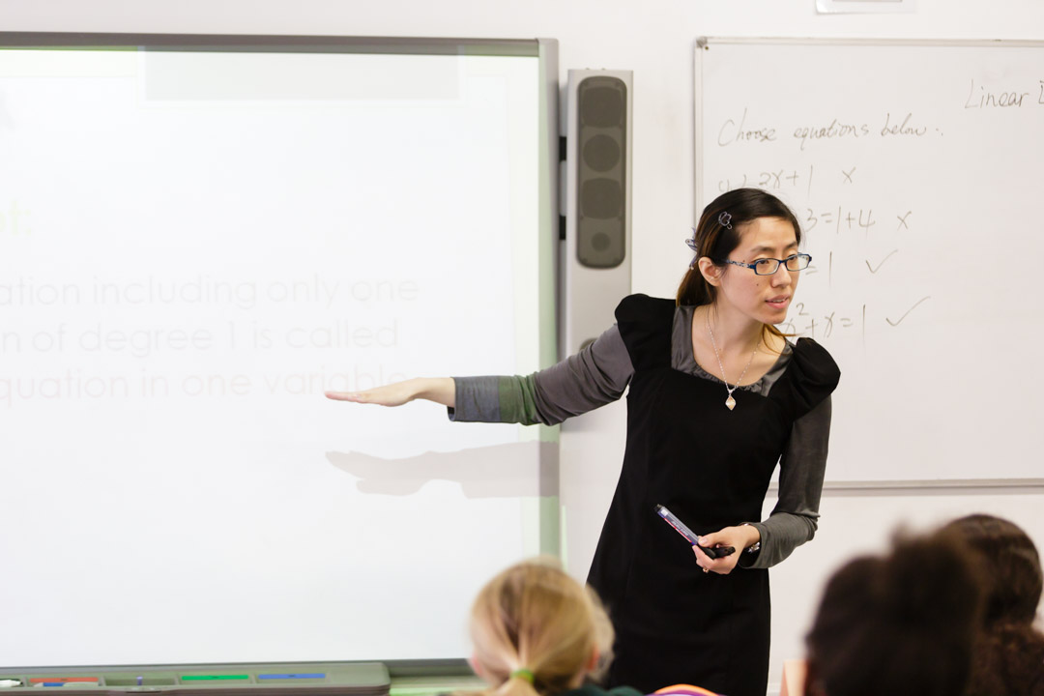
www.mathshubl2.com
@MathsHubLdnCNW

Slide 4
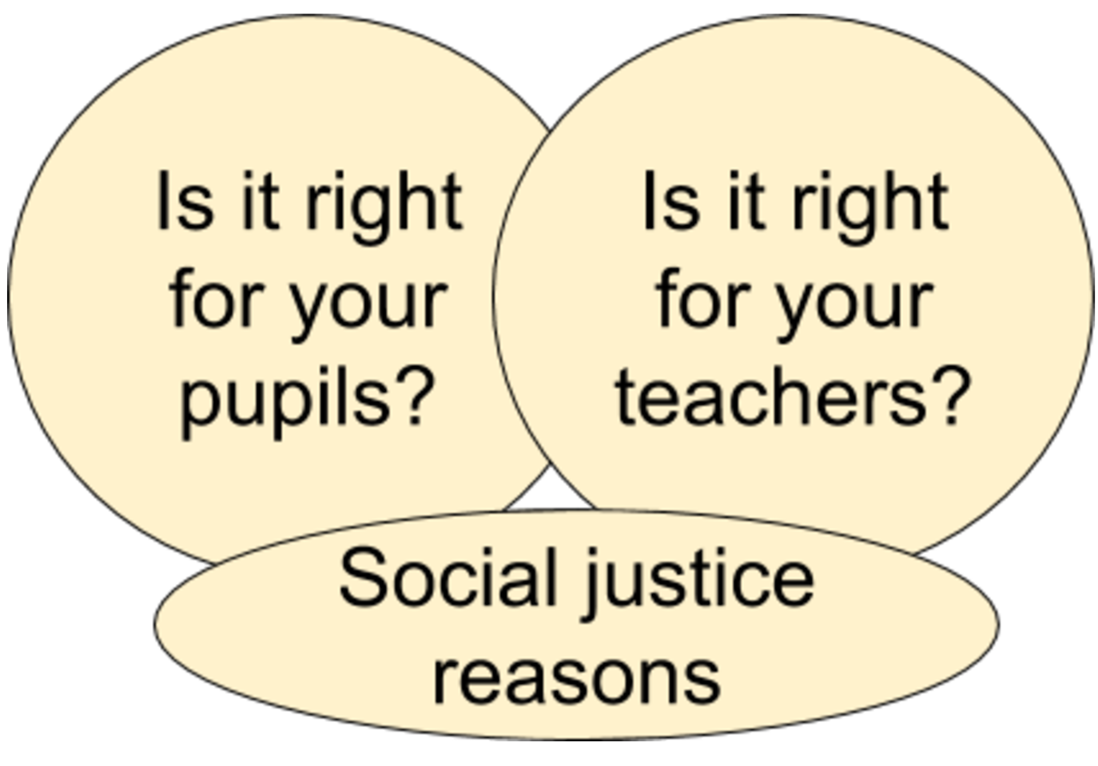

Slide 5
http://www.bristol.ac.uk/media-library/sites/cmpo/documents/taylor2016.pdf

Slide 6
The Challenge of differentiation
At any point in time, different learners will proceed at different rates AND have different foundational knowledge
Every minute is valuable

Slide 7
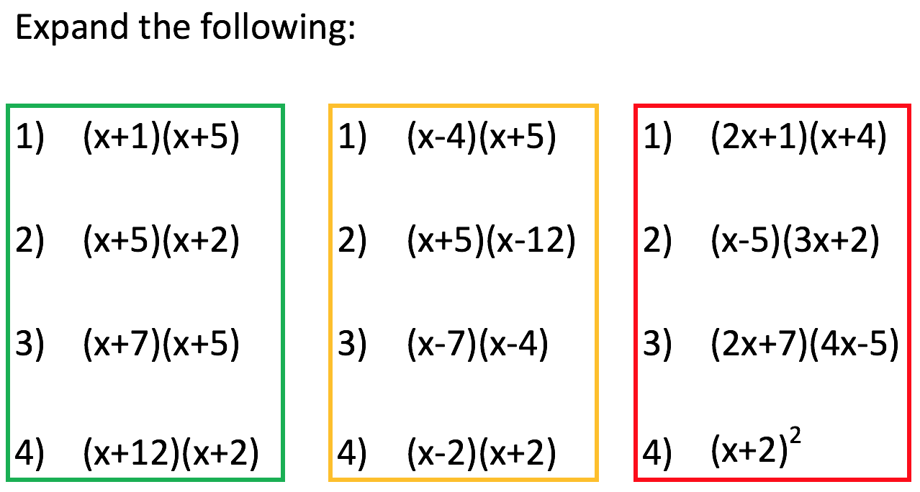

Slide 9
Introduce Algebra early in Year 7
The basics
Collecting like terms
Substitution
Distributive and Associative Laws applied to arithmetic and algebra
Carefully avoiding negatives
E.g. 5(a + 3b) – 2a
But not 5(a + 3b) – 8a

Slide 10
What can you say about a and b?
1)
2)
3)
4)
5)
6)

Slide 11
TRUE of FALSE
To multiply by 10, you add zero to a number
3.4 $×$ 100 = 3.400
4.56 ÷ 100 = 0.456
340 ÷ 10 = 34.0
0.83 $×$ 1000 = 83
Dividing by 100 is the same as dividing by 10 twice
To multiply by 100, you move the decimal point two places to the right

Slide 12
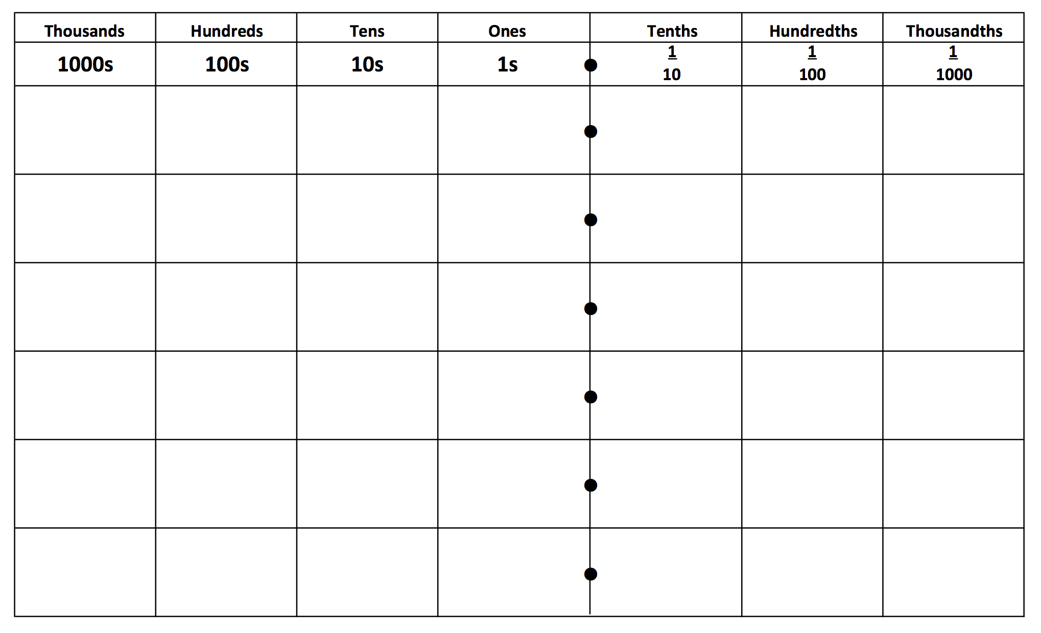

Slide 13
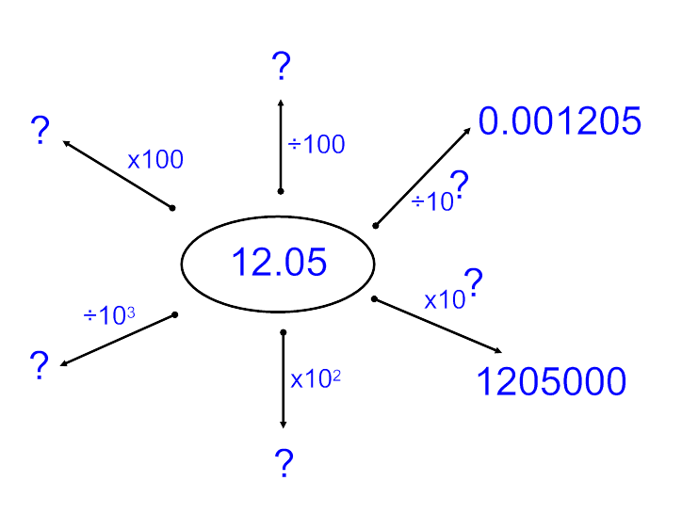

Slide 14
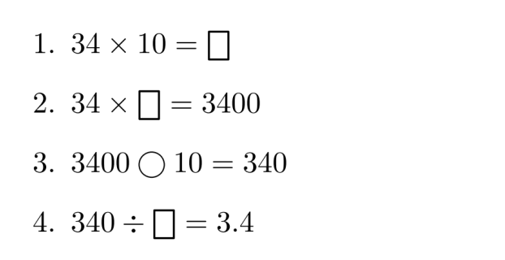
Fill the boxes and continue the pattern
34 ◯ ☐ = 3.4
34 ◯ ☐ = 3.4
34 ◯ ☐ = 0.34
34 ◯ ☐ = 0.34
34 ◯ ☐ = 0.034
34 ◯ ☐ = 0.034

Slide 15
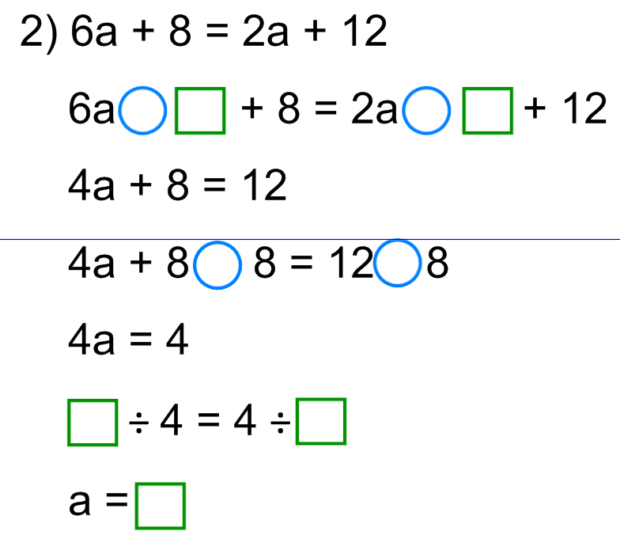

Slide 16
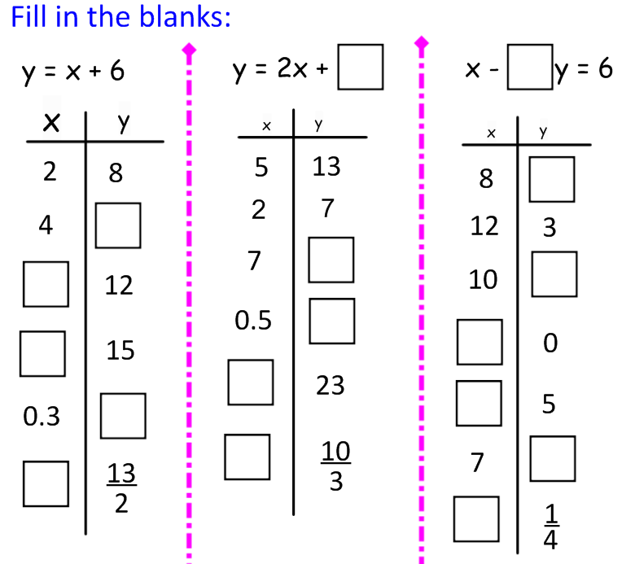

Slide 17
Collaborative lesson planning
All Yr7 teachers meet once per week for 1 period. (Same for Yr8 teachers)
Review plans already made for the week ahead.
Plan 2 weeks ahead.
Weekly TRG
Review
Week A
Plan
Weekly TRG
Plan
Week B
Review
Weekly TRG
Week B
Review
Plan

Slide 19
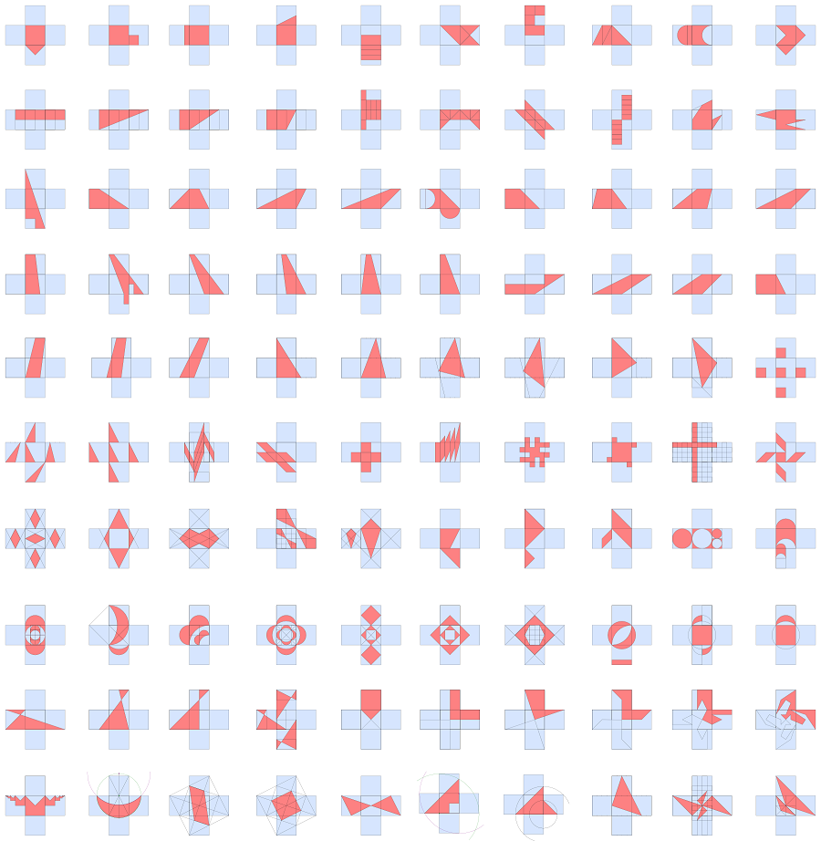

Slide 21
